Slide 1


PROJECT 4 :
MACHINE
LEARNING
Catherine, Gita, Kabir, Wisdom

Slide 2
DATA : SEATTLE WEATHER (2012 - 2015)
Source : Kaggle (--- LINK ---)
PANDAS
MATPLOTLIB
Clean Data
Visualize with Matplotlib
TABLEAU
Deeper visualization in Tableau to gain more understanding about the data.
MACHINE LEARNING
Random Forest
Linear Regression
Neural Network
Logistic Regression

Slide 3
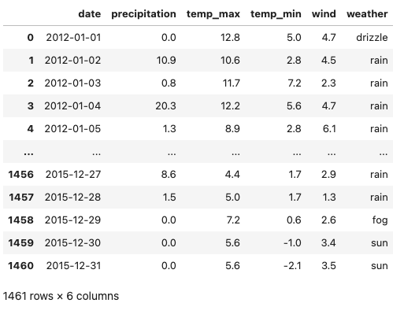

How does the data look like :

Slide 4


VISUALIZATION : PANDAS & MATPLOTLIB
VARIABLES CORRELATION
WEATHER FREQUENCY
AVERAGE VARIABLES BY MONTH

Slide 5
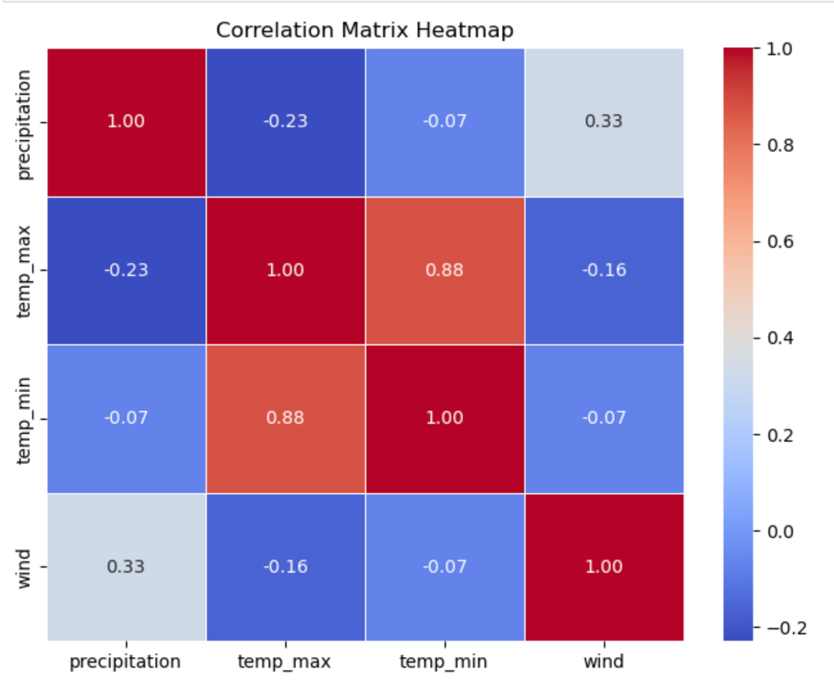
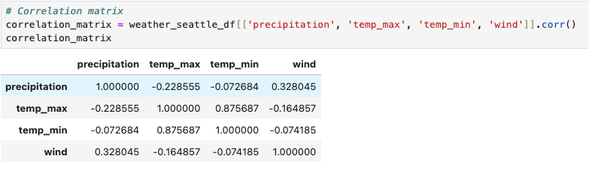
Close to 1: Strong positive correlation.
Close to -1: Strong negative correlation.
Close to 0: No correlation.

Slide 6
Key Takeaways:
• Temperature (max & min) is the most strongly correlated variable in the dataset.
• Wind and precipitation have a moderate positive relationship, suggesting that windier conditions might be associated with more precipitation.
• Precipitation has a weak negative relationship with temperature, indicating a slight tendency for rainier conditions to be associated with cooler temperatures.
• Wind and temperature have weak negative correlations, meaning stronger winds might be slightly associated with lower temperatures.

Slide 7
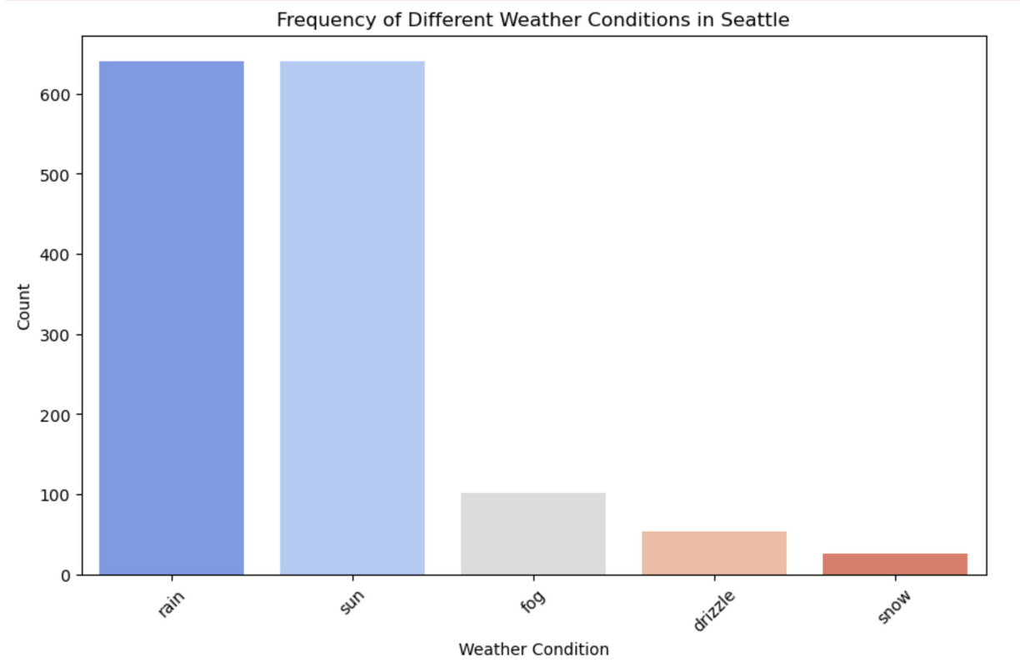
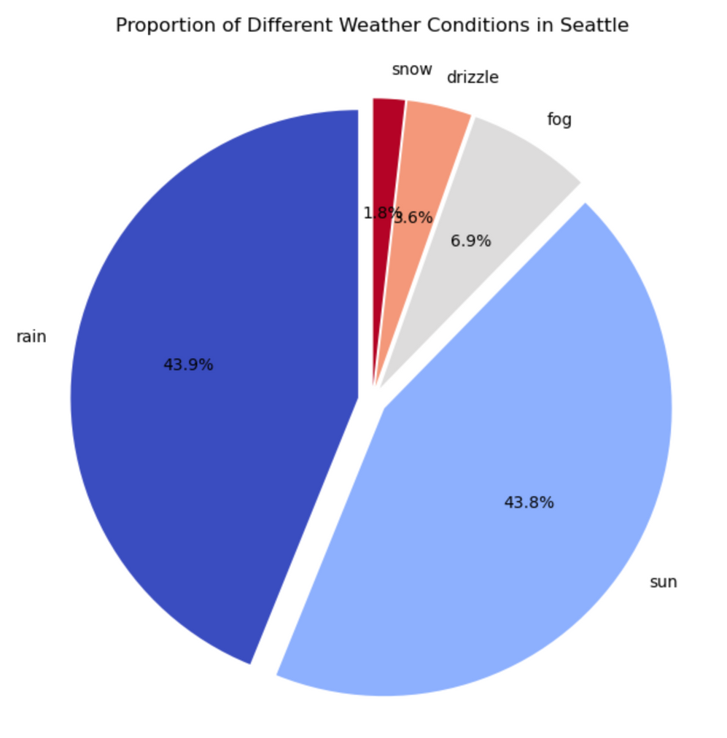
WEATHER FREQUENCY

Slide 8
Key Takeaways:
1. Seattle has a nearly even split between sunny and rainy days (~44% each), which aligns with its reputation for frequent rain but also significant sunshine.
2. Fog is a minor but notable weather condition, appearing around 7% of the time.
3. Drizzle and snow are the least common weather types, with snow being very rare (only 1.8% of occurrences).

Slide 9
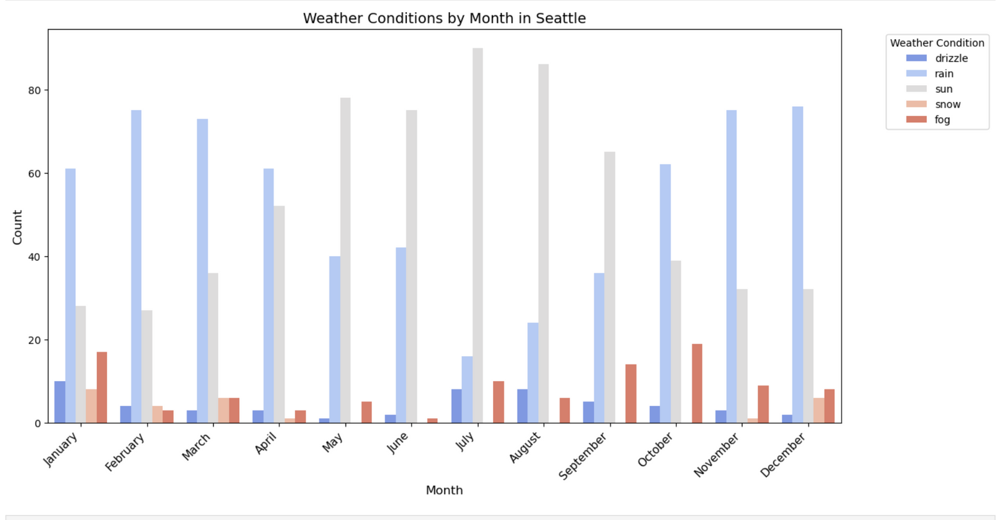
MONTHLY WEATHER CONDITION

Slide 10
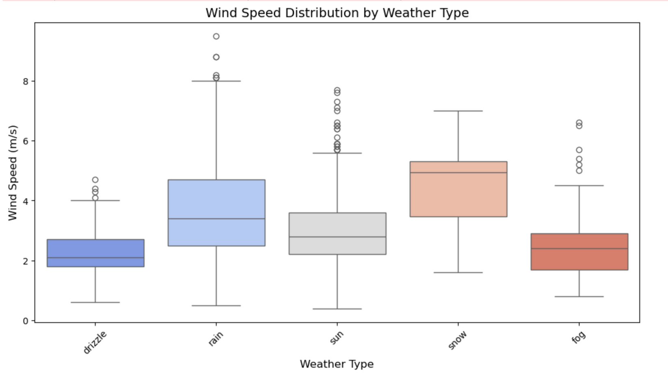
WIND SPEED BY WEATHER TYPE

Slide 11
Bar Charts :
1. Rain is the most frequent weather condition across all months, with peaks in winter months (November–March).
2. Sun is more common in summer (June–August) and significantly decreases in the rainy months.
3. Drizzle and fog appear throughout the year but are more prominent in the colder months.
4. Snow is infrequent and occurs mainly in winter months (December–February).
Box Plot :
1. Snow has the highest median wind speed, indicating windier conditions during snowfall.
2. Rain and sun have a wide range of wind speeds, including high outliers (above 8 m/s).
3. Drizzle and fog have the lowest median wind speeds, suggesting calmer weather during these conditions.
4. There are multiple outliers, especially for rain and snow, showing that extreme wind speeds occur occasionally.

Slide 12
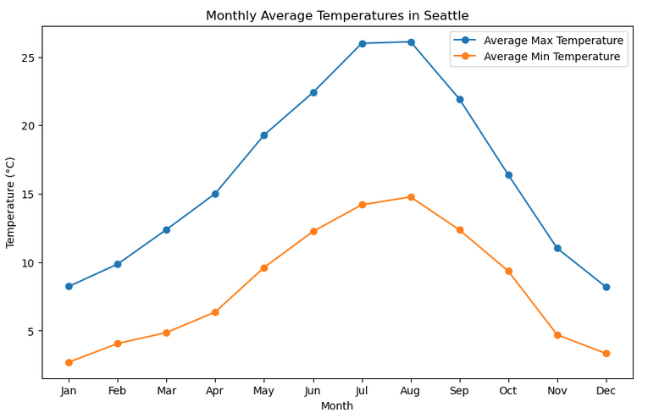
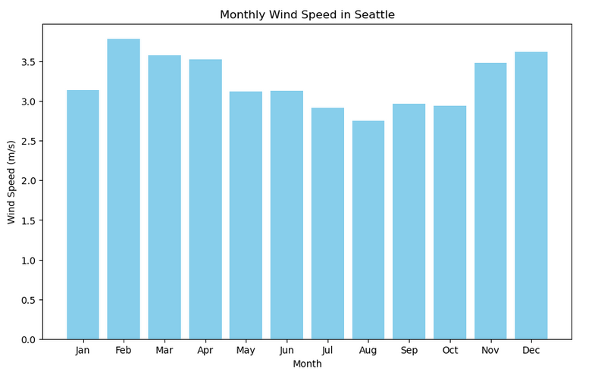
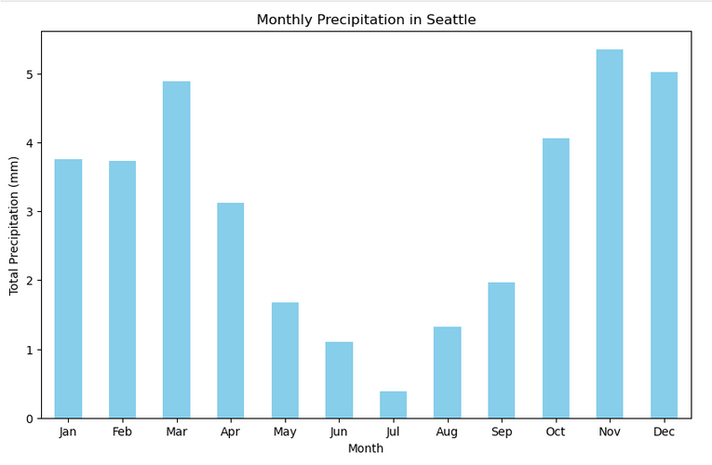
AVERAGE VARIABLES BY MONTH

Slide 13
Temperature : Peaks in summer (July - August) and drops in winter (December - February)
2. Precipitation : Winter and fall are the wettest seasons, while summer is dry.
3. Wind Speed : Higher in winter, lower in summer.

Slide 14
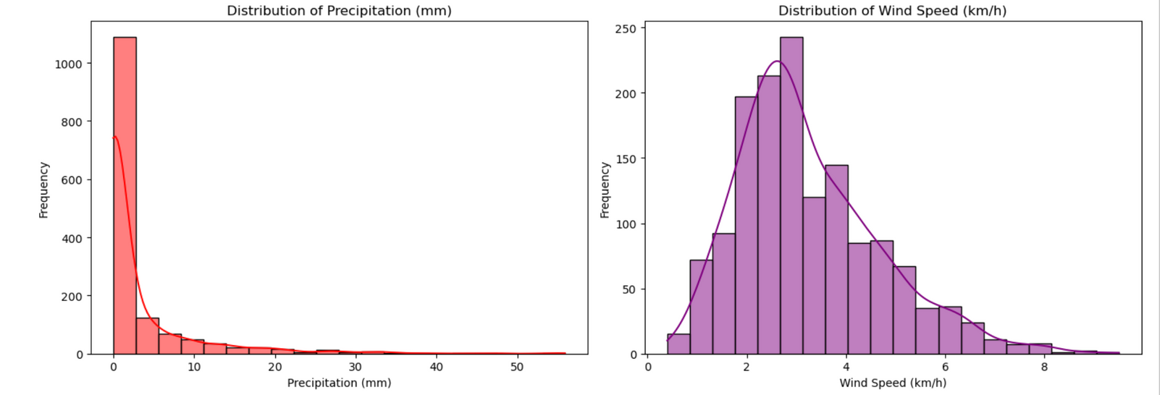
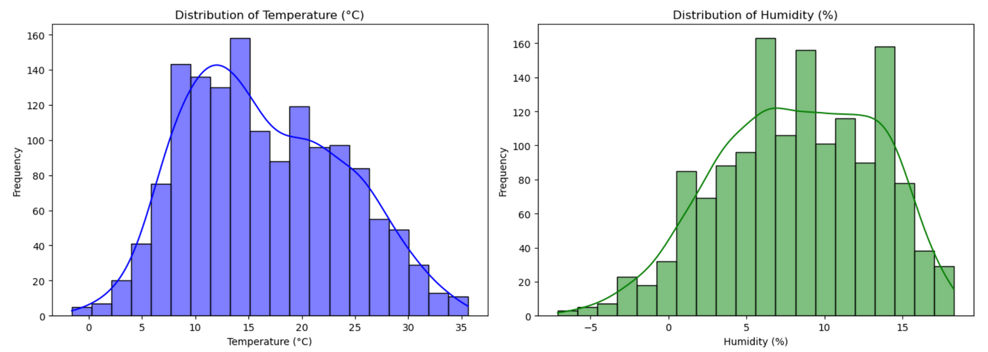
VARIABLES DISTRIBUTION

Slide 15
Key takeaway :
1. Seattle’s precipitation is mostly light, but heavy rain does occur occasionally.
2. Wind speeds are generally low to moderate, with some strong wind events.
3. Temperature follows a normal pattern, suggesting stable seasonal variation.
4. Humidity is somewhat normally distributed but can vary significantly.

Slide 16

VISUALIZATION : TABLEAU

Slide 17
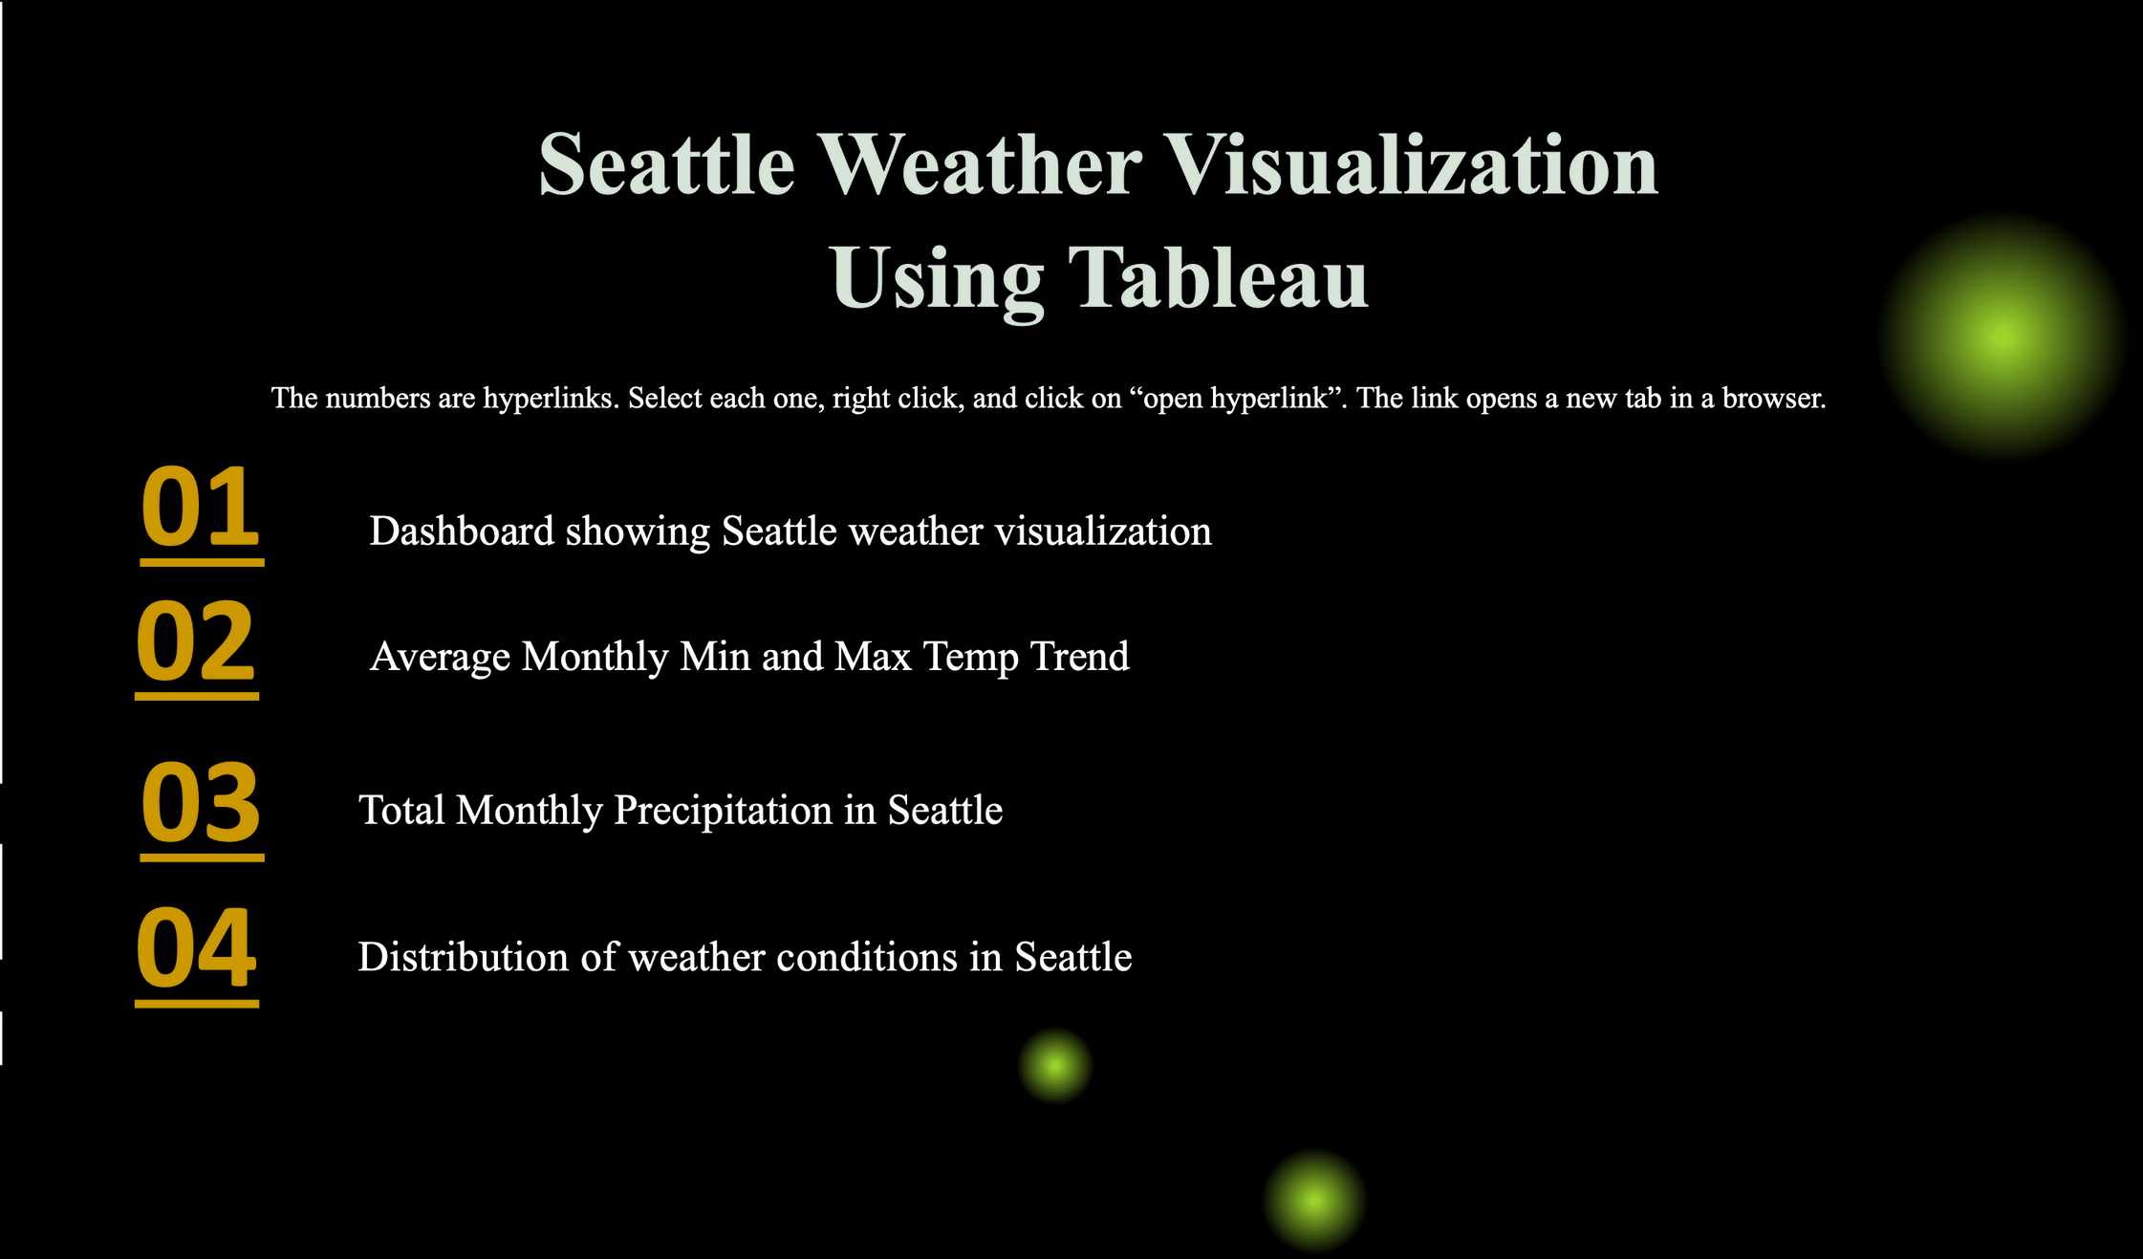

Slide 18
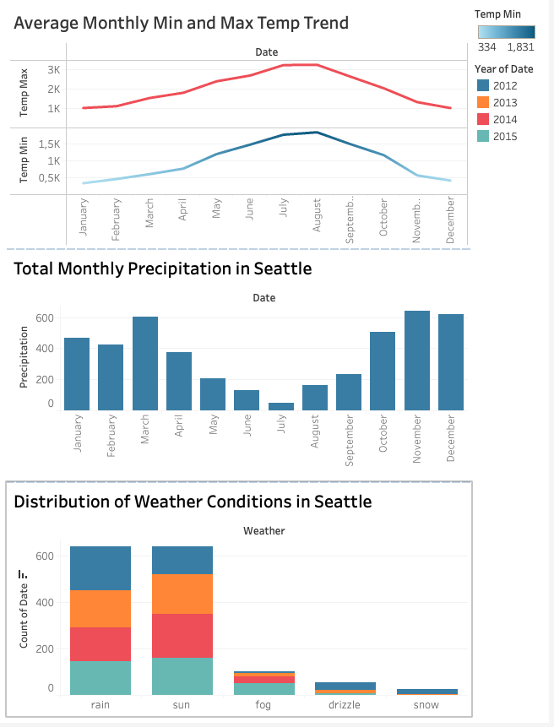

Slide 19

MACHINE LEARNING
RANDOM FOREST
LINEAR REGRESSION
VECTOR
LOGISTIC REGRESSION

Slide 20
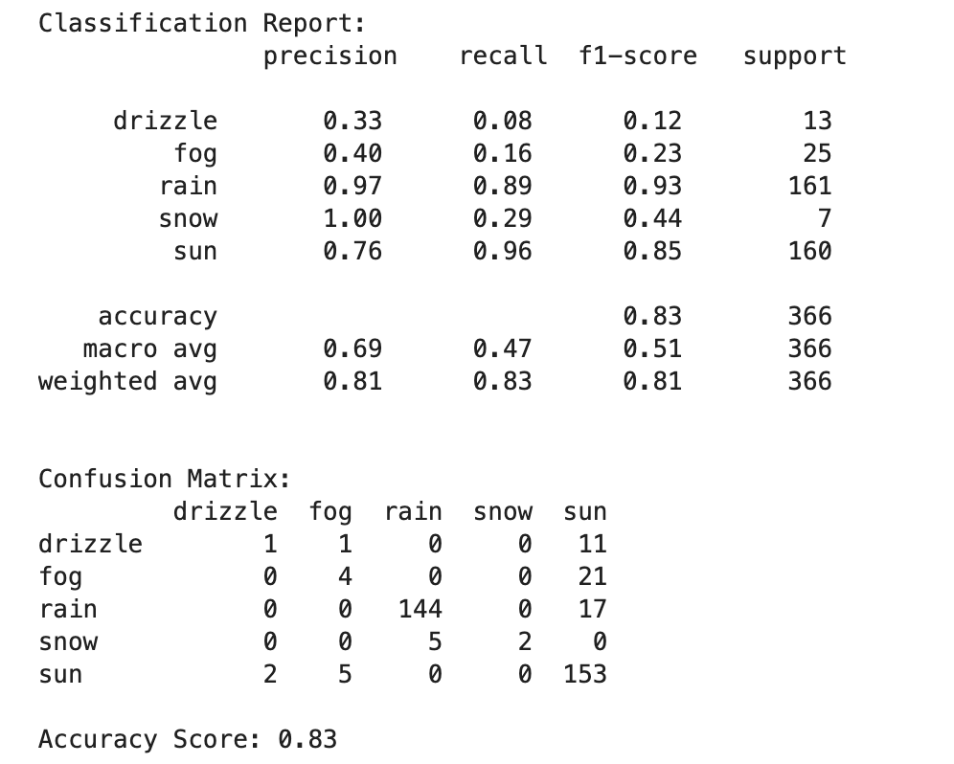
RANDOM FOREST
Interpretation based on the data :
Rain: Precision = 0.97, Recall = 0.89, F1-Score = 0.93 * The model correctly classifies rainy days 97% of the time (Precision).
* It captures 89% of actual rainy days (Recall). * F1-score of 0.93 shows overall strong performance.
Drizzle: Precision = 0.33, Recall = 0.08, F1-score = 0.12 * The model struggles to classify drizzle, it might be many drizzle days are misclassified. * This suggests that drizzle is hard to differentiate from other conditions.
Accuracy Score = 0.83 (83%)
Meaning: The model correctly predicts 83% of weather conditions.
Limitation: Accuracy does not consider class imbalance (some weather types might be rare).

Slide 21
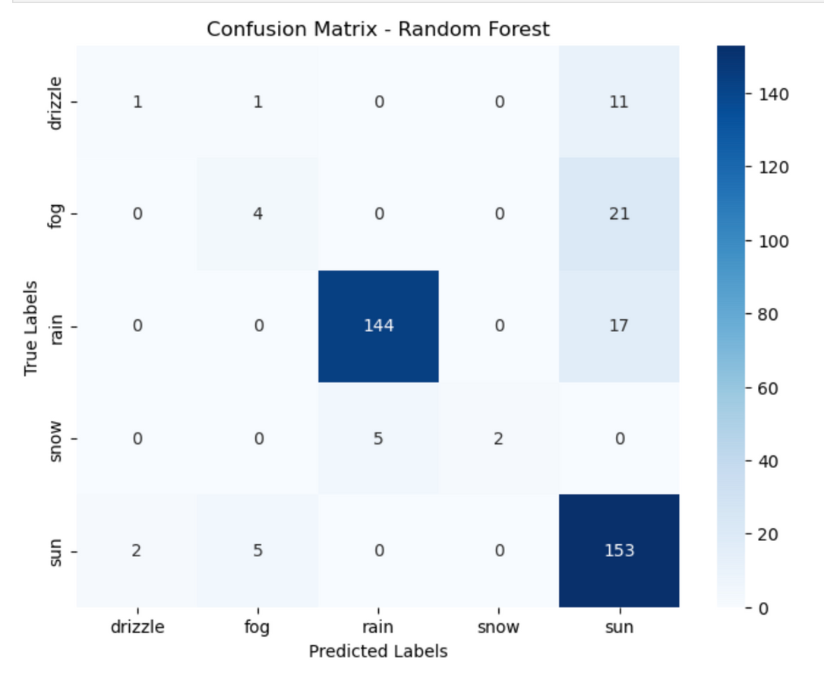
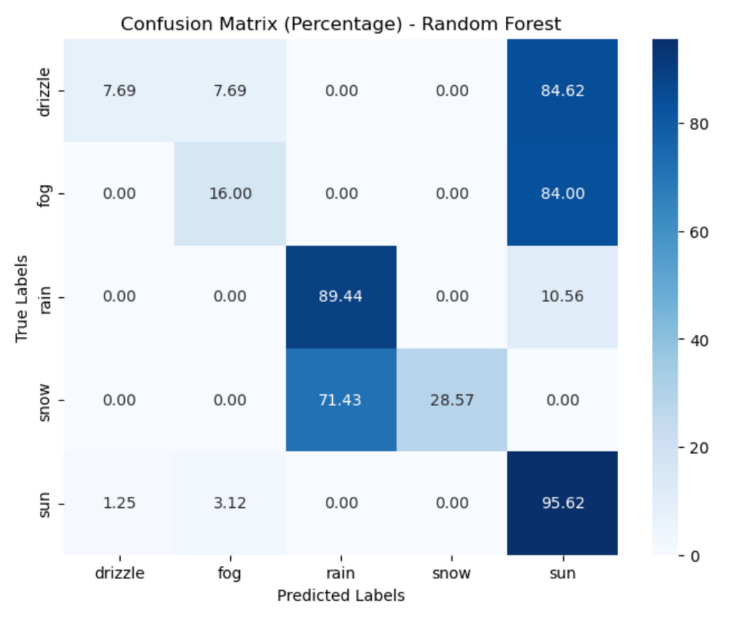
RANDOM FOREST EVALUATION : CONFUSSION MATRIX

Slide 22
Interpretation based on the data :
If Rain has 144 in its row under the Rain column, it means 144 rainy days were correctly classified.
If Rain has 17 under Sun, it means 17 rainy days were misclassified as sunny days.
* “Sun → Sun” = 95.62% → The model correctly predicts sunny weather 95.62% of the time.
* “Snow → Rain” = 71.43% → The model misclassifies 71.43% of snowy days as rainy.
* “Drizzle → Sun” = 84.62% → Most drizzle days are incorrectly classified as sunny.
Conclusion
* Rainy and Sunny days are well-classified, based on high precision and recall.
* Drizzle and Fog show weaker performance, meaning they might need more feature engineering.
* Improvement Suggestions:
* Use more features (e.g., humidity, pressure) to differentiate conditions.
* Use a balanced dataset to improve classification of rare weather types.
* Retrieve more data using open API (e.g., Open Weather Data)

Slide 23


Slide 24
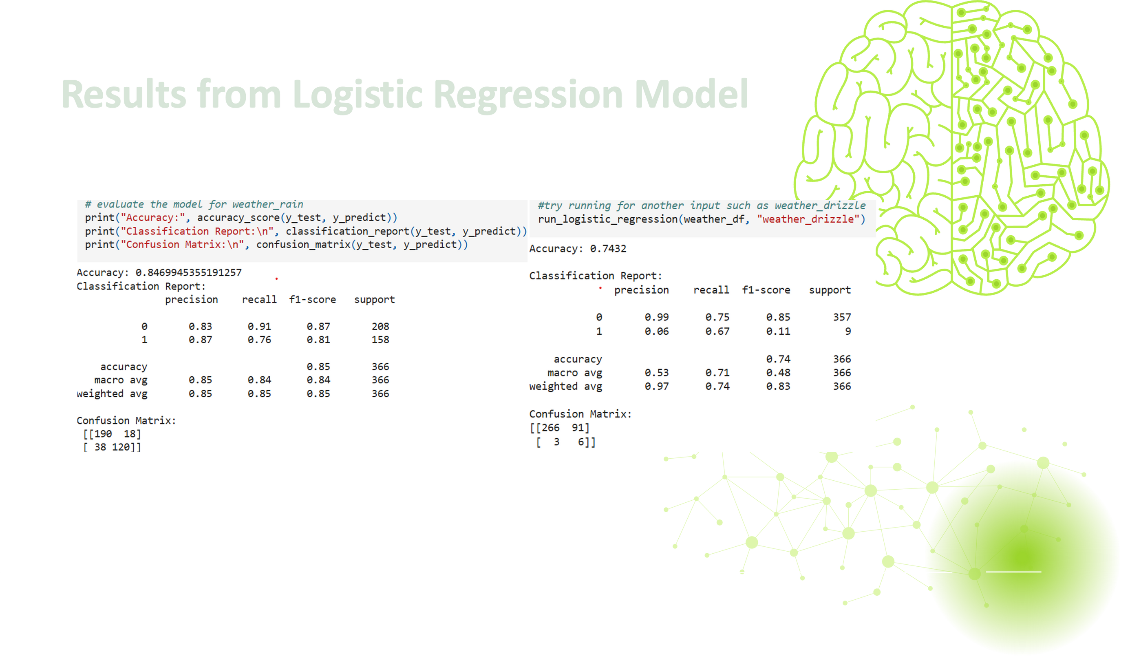

Slide 25
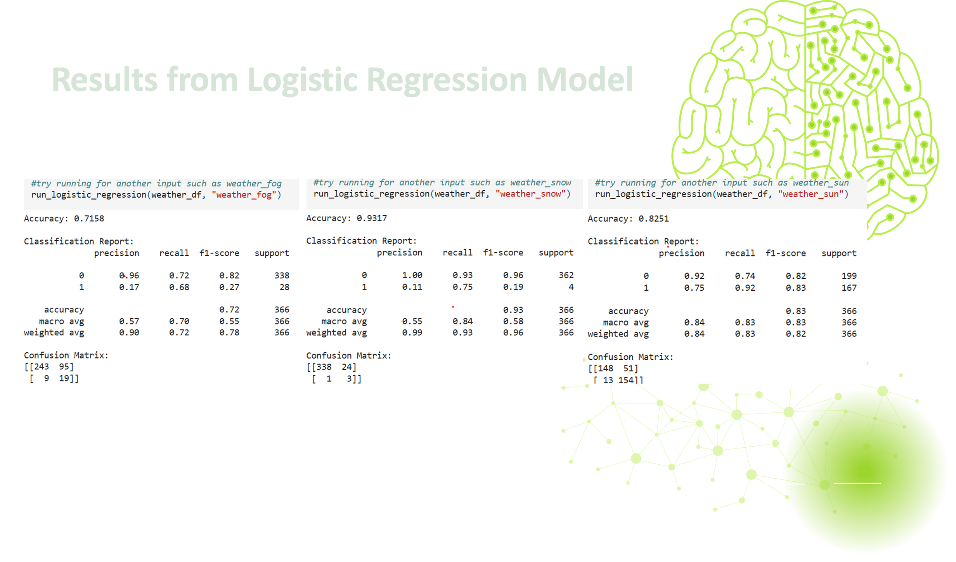

Slide 26
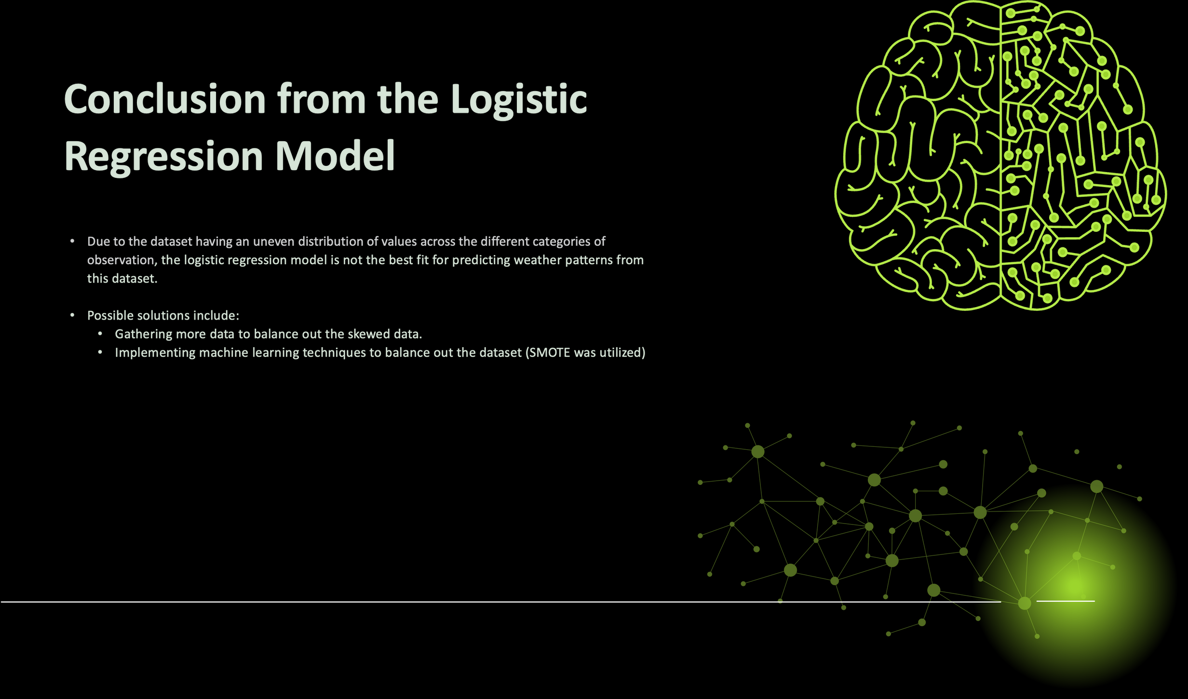

Slide 27
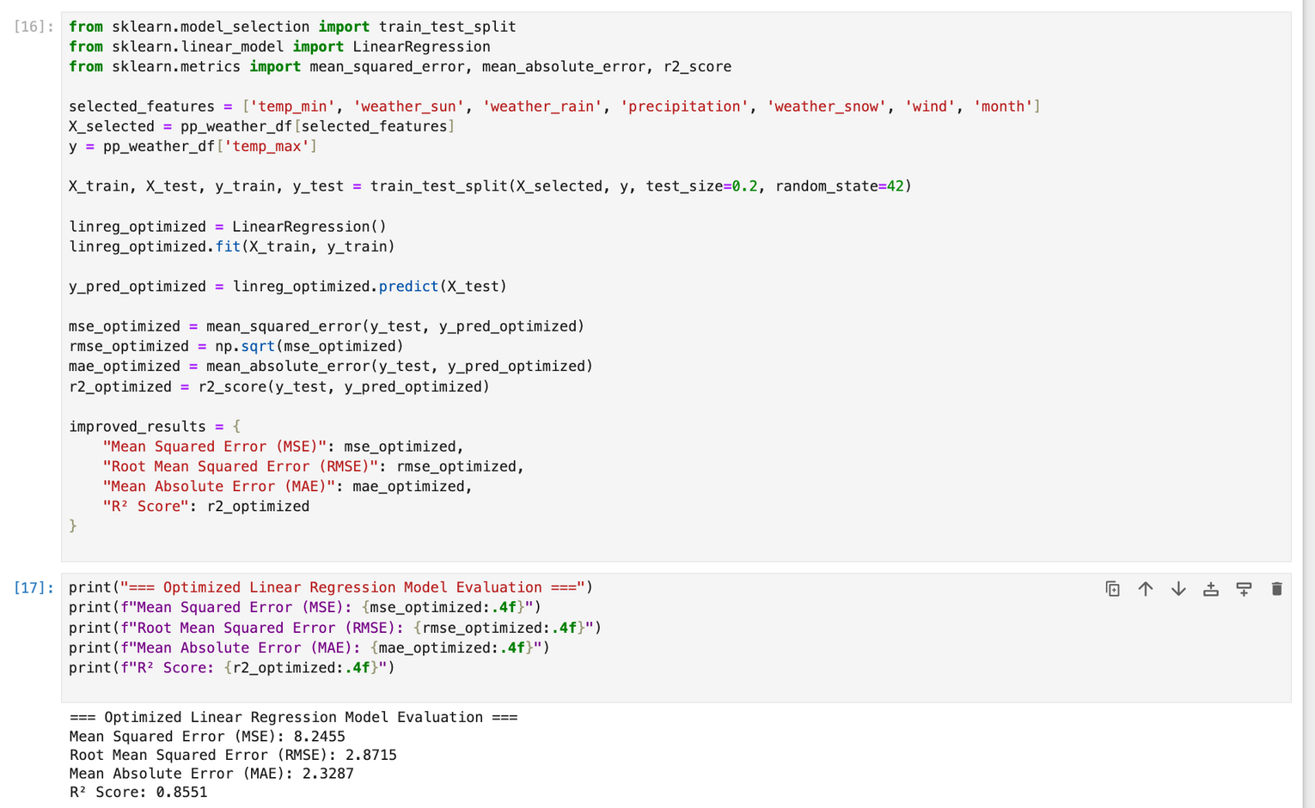
LINEAR REGRESSION

Slide 28
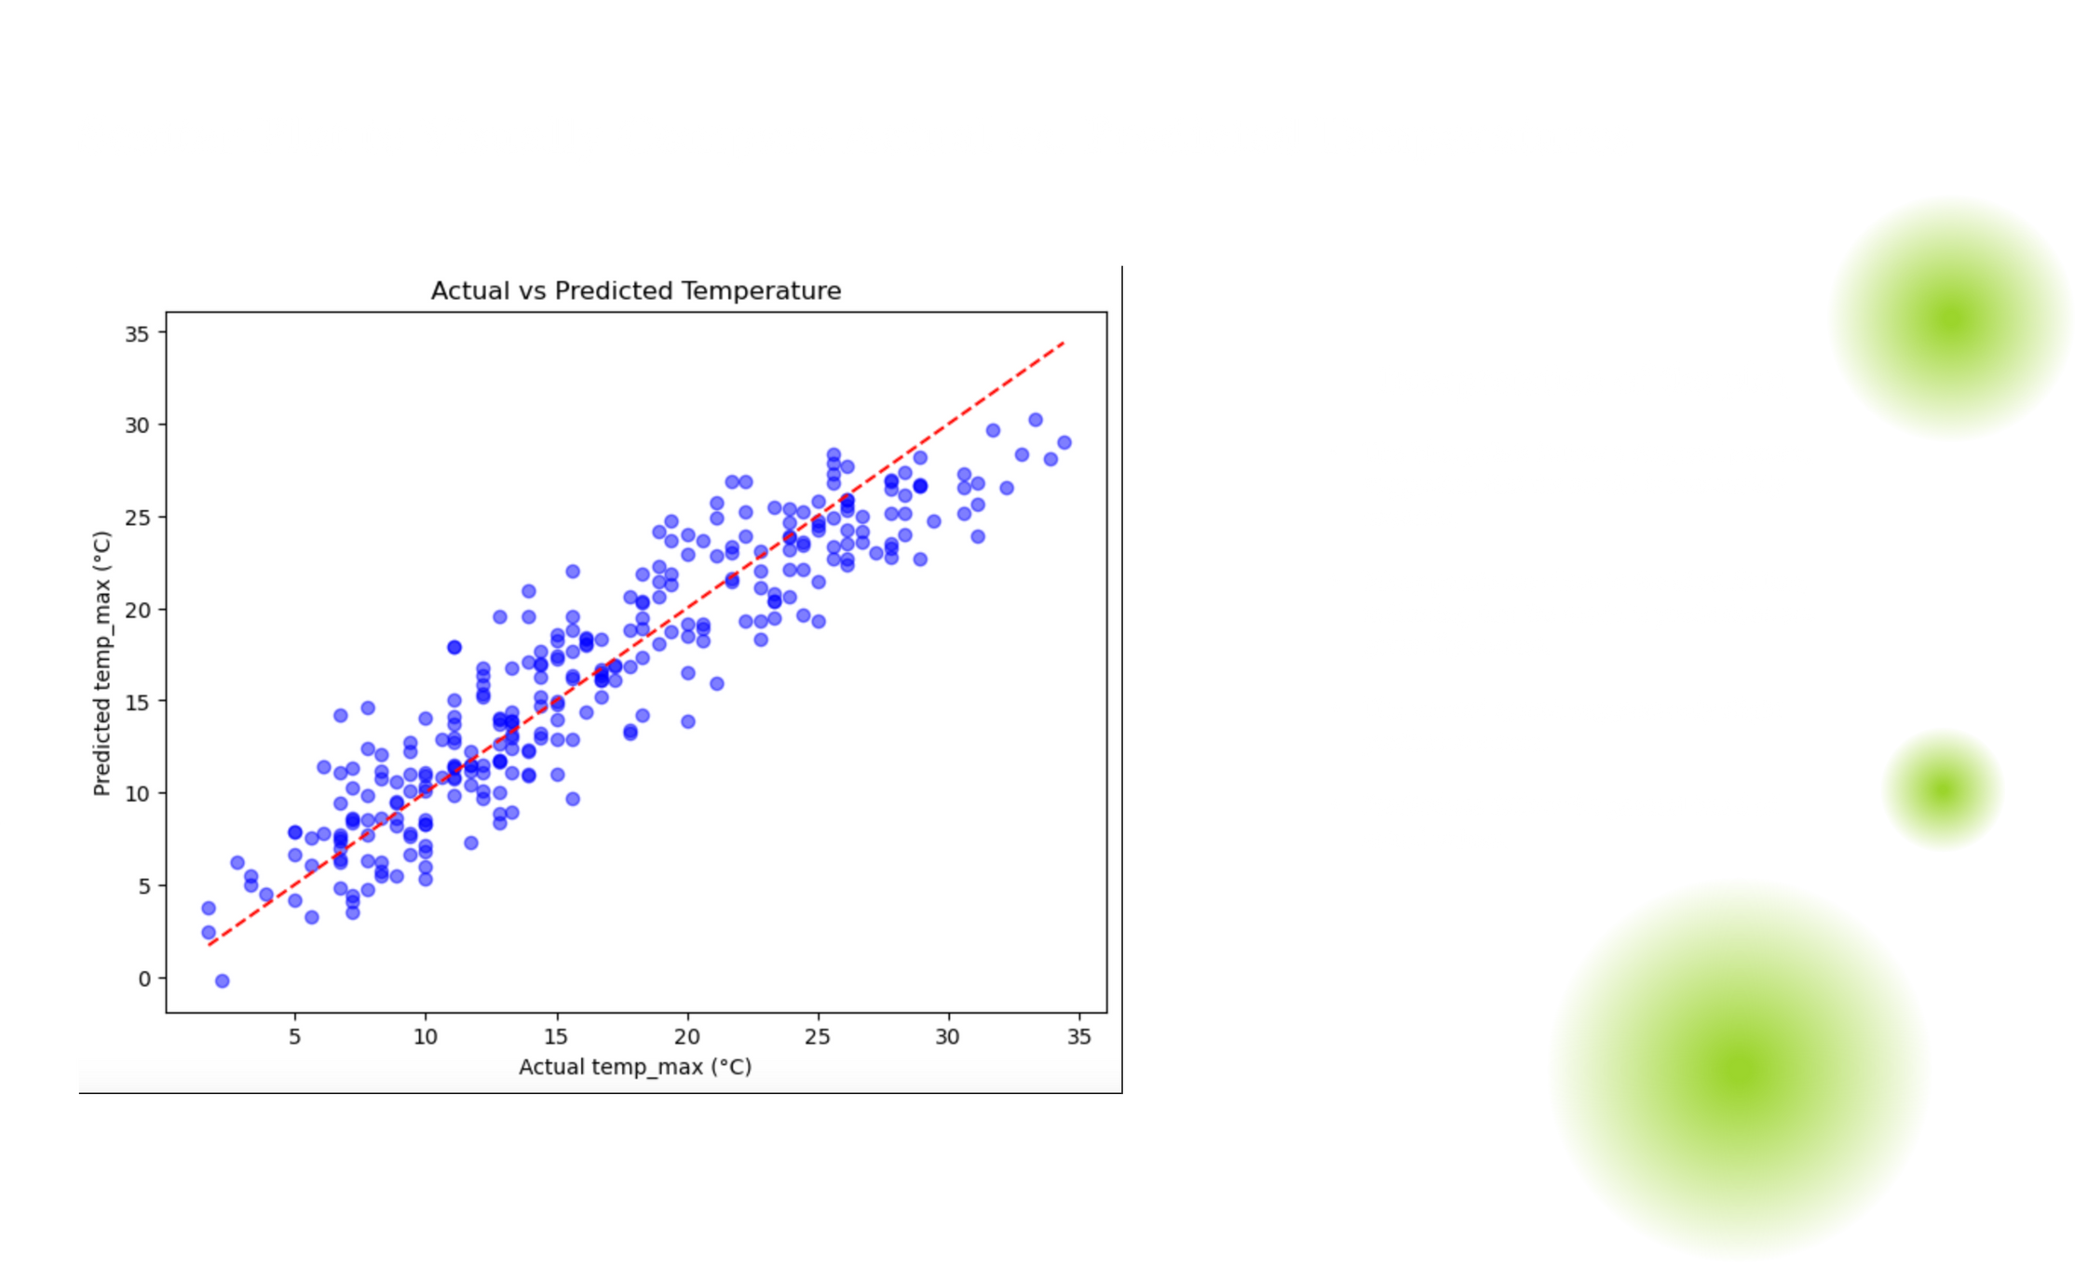

Slide 29
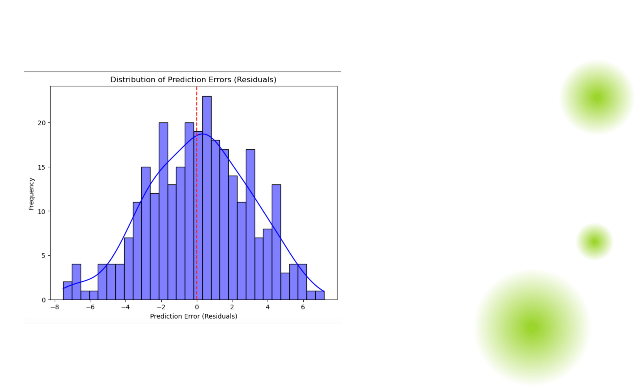

Slide 30
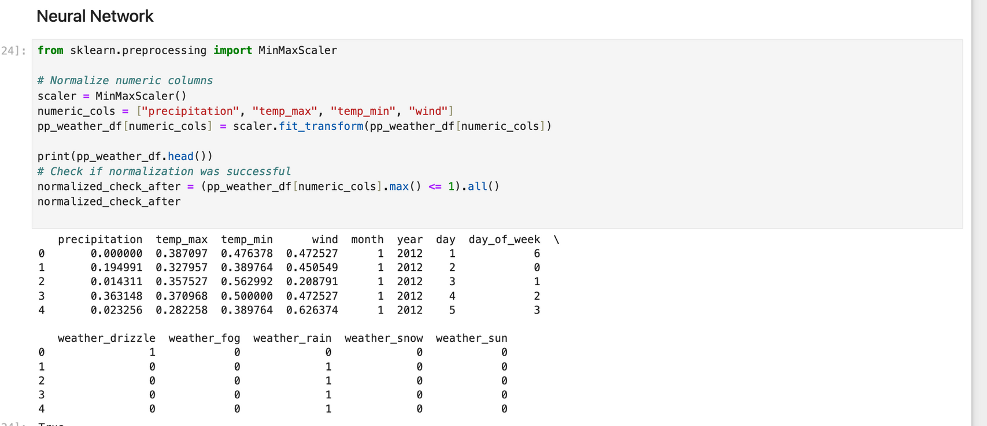
NEURAL NETWORKS

Slide 31
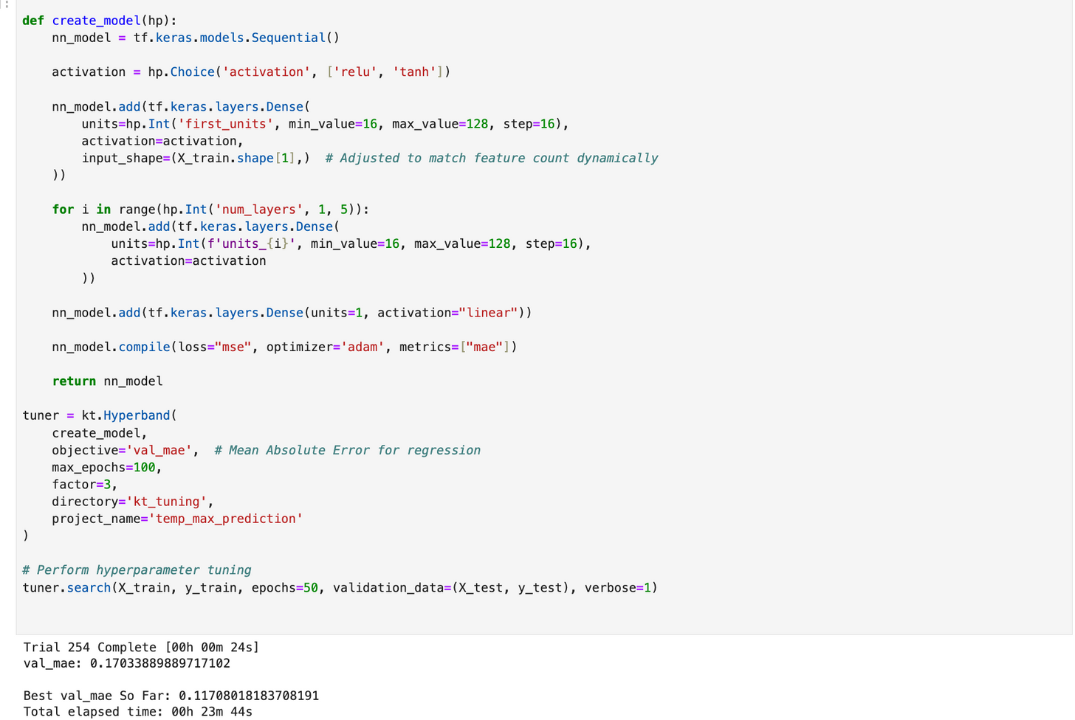
NEURAL NETWORKS

Slide 32
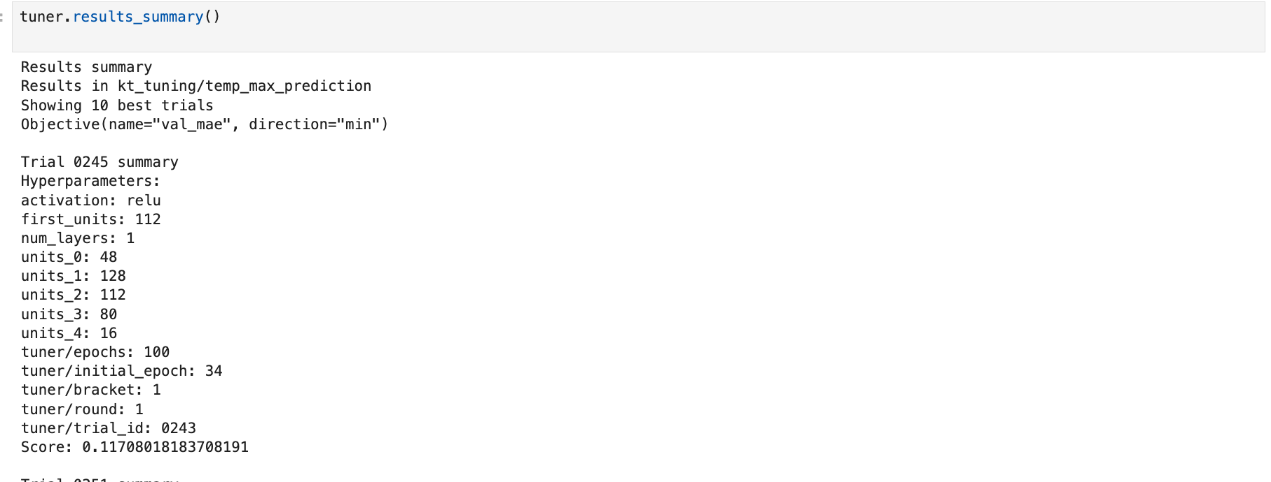
NEURAL NETWORKS

Slide 33
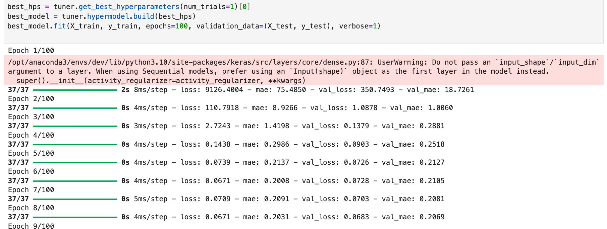
NEURAL NETWORKS

Slide 34
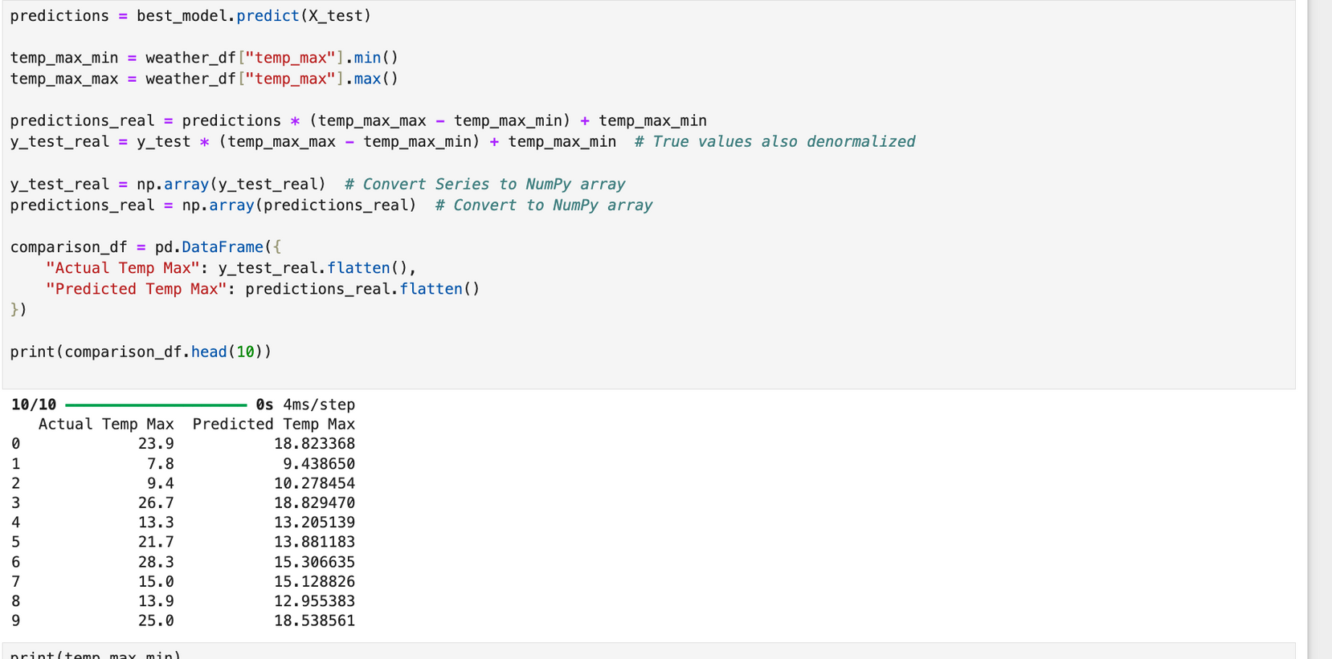
NEURAL NETWORKS

Slide 35
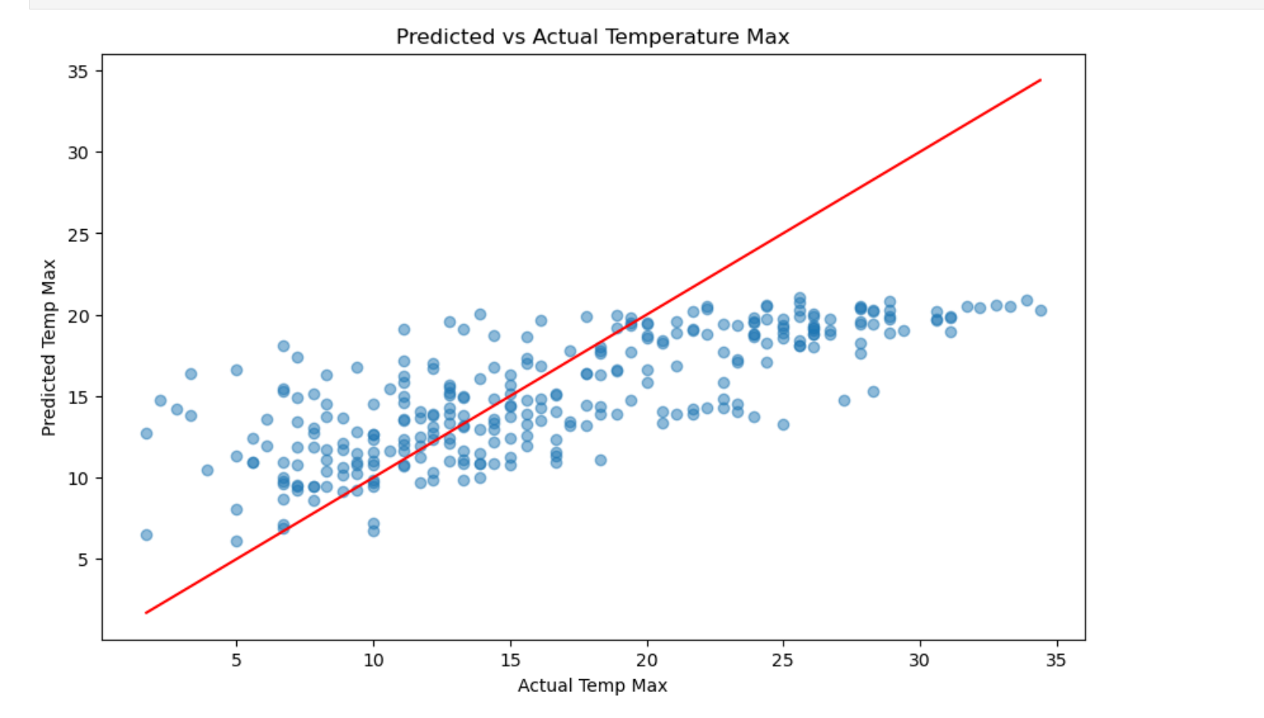
NEURAL NETWORKS

Slide 36
Conclusion:
The Neural Network model we created was not that accurate and had a normalized MAE of ~0.117 which is about 4.37 C. Neural Networks require many rows of data to develop, and due to the smaller data size we may suffer from some overfitting issues. For this specific case, therefore, linear regression is a better machine learning model than our tried neural network with its respective hyperparameters

